Slide 1
DIABETES PREDICTION USING DIFFERENT METHODS / MODELS AND FINDING HIGH ACCURACY MODEL

Slide 2
HARD WARE REQUIREMENTS
PERSONAL COMPUTER
PROCESSOR : ANY INTEL OR AMD PROCESSOR
RAM : Minimum 1GB required

Slide 3
Software Requirements
PYTHON 3.6
JUPYTER NOTE BOOK
NUMPY , PANDAS ,SKLEARN ,MATPLOTLIB libraries

Slide 4
INTRODUCTION
Diabetes is a type of chronic disease which is more common among the people of all age groups. Predicting this disease at an early stage can help a person to take the necessary precautions and change his/her lifestyle accordingly to either prevent the occurrence of this disease or control the disease(For people who already have the disease). Diabetes is a disease that occurs when your blood glucose, also called blood sugar, is too high. Blood glucose is your main source of energy and comes from the food you eat. Insulin, a hormone made by the pancreas, helps glucose from food get into your cells to be used for energy. Sometimes your body doesn’t make enough—or any—insulin or doesn’t use insulin well. Glucose then stays in your blood and doesn’t reach your cells.
Type 1 diabetes
If you have type 1 diabetes, your body does not make insulin. Your immune system attacks and destroys the cells in your pancreas that make insulin. Type 1 diabetes is usually diagnosed in children and young adults, although it can appear at any age. People with type 1 diabetes need to take insulin every day to stay alive.
Type 2 diabetes
If you have type 2 diabetes, your body does not make or use insulin well. You can develop type 2 diabetes at any age, even during childhood. However, this type of diabetes occurs most often in middle-aged and older people. Type 2 is the most common type of diabetes.

Slide 5
Steps:
LOADING DATASET
DATA VISUALIZATION
Spliting Data set in to training and testing sets
Fitting the training set in to each model and predicted labels
Calculating Accuracy of each model and finding the highest accuracy

Slide 6
Loading Dataset
DATA SET : A data set (or dataset) is a collection of data. In the case of tabular data, a data set corresponds to one or more database tables, where every column of a table represents a particular variable, and each row corresponds to a given record of the data set in question. The data set lists values for each of the variables, such as height and weight of an object, for each member of the data set. Each value is known as a datum. Data sets can also consist of a collection of documents or files.
For this project data set is collected from UCI machine learning respository. Named as Diabetes.csv. The data set is in the csv format.
In order to read the data set import the module pandas
Along with pandas import numpy , sklearn , matplotlib
If in case this libraries are not install with command pip install pandas or conda install pandas , similary for other libraries just change the name.

Slide 7
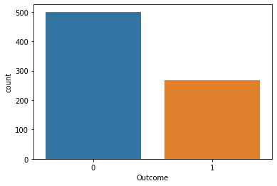
Counter plot of the outcome
Analyzing and Visualizing Dataset
Pregnancies | Glucose | BloodPressure | SkinThickness | Insulin | BMI | DiabetesPedigreeFunction | Age | Outcome
count | 768.000000 | 768.000000 | 768.000000 | 768.000000 | 768.000000 | 768.000000 | 768.000000 | 768.000000 | 768.000000
mean | 3.845052 | 120.894531 | 69.105469 | 20.536458 | 79.799479 | 31.992578 | 0.471876 | 33.240885 | 0.348958
std | 3.369578 | 31.972618 | 19.355807 | 15.952218 | 115.244002 | 7.884160 | 0.331329 | 11.760232 | 0.476951
min | 0.000000 | 0.000000 | 0.000000 | 0.000000 | 0.000000 | 0.000000 | 0.078000 | 21.000000 | 0.000000
25% | 1.000000 | 99.000000 | 62.000000 | 0.000000 | 0.000000 | 27.300000 | 0.243750 | 24.000000 | 0.000000
50% | 3.000000 | 117.000000 | 72.000000 | 23.000000 | 30.500000 | 32.000000 | 0.372500 | 29.000000 | 0.000000
75% | 6.000000 | 140.250000 | 80.000000 | 32.000000 | 127.250000 | 36.600000 | 0.626250 | 41.000000 | 1.000000
max | 17.000000 | 199.000000 | 122.000000 | 99.000000 | 846.000000 | 67.100000 | 2.420000 | 81.000000 | 1.000000

Slide 8
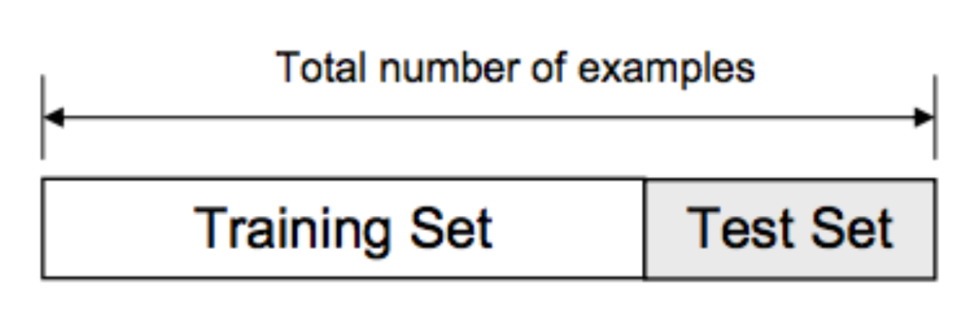
Train/Test Split
The data we use is usually split into training data and test data. The training set contains a known output and the model learns on this data in order to be generalized to other data later on. We have the test dataset (or subset) in order to test our model’s prediction on this subset.
.

Slide 9
Predicting this disease at an early stage help the person to take the necessary precautions. In this for the purpose of predicting the diabetes four different classification models are used.
They are:
K nearest neighbors
Logistic Regression
Decision Trees
Support Vector Machine

Slide 10
K Nearest Neighbors Classification
K-nearest neighbors (KNN) algorithm is a type of supervised ML algorithm which can be used for both classification as well as regression predictive problems. However, it is mainly used for classification predictive problems in industry.

Slide 11
Working of K nearest neighbors algorithm
K-nearest neighbors (KNN) algorithm uses ‘feature similarity’ to predict the values of new datapoints which further means that the new data point will be assigned a value based on how closely it matches the points in the training set. We can understand its working with the help of following steps −
Step 1 − For implementing any algorithm, we need dataset. So during the first step of KNN, we must load the training as well as test data.
Step 2 − Next, we need to choose the value of K i.e. the nearest data points. K can be any integer.
Step 3 − For each point in the test data do the following −
3.1 − Calculate the distance between test data and each row of training data with the help of any of the method namely: Euclidean, Manhattan or Hamming distance. The most commonly used method to calculate distance is Euclidean.
3.2 − Now, based on the distance value, sort them in ascending order.
3.3 − Next, it will choose the top K rows from the sorted array.
3.4 − Now, it will assign a class to the test point based on most frequent class of these rows.

Slide 12
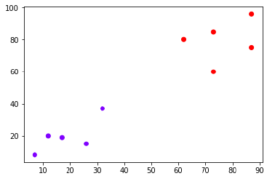
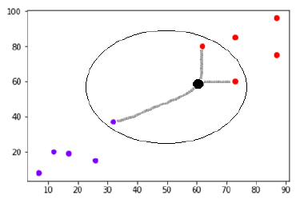
Example
The following is an example to understand the concept of K and working of KNN algorithm −
Suppose we have a dataset which can be plotted as follows :
Now, we need to classify new data point with black dot (at point 60,60) into blue or red class. We are assuming K = 3 i.e. it would find three nearest data points. It is shown in the next diagram −

Slide 13
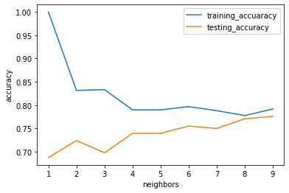
Implementing this K nearest neighbors algorithm with python gives the following for the different K values gave the following output:
From the above graph we can observe that at around the point k = 8 -9 the both training and testing dataset got approximately equal accuracy, hence taking value of k = 8 or 9 gives the best prediction on the data set . Hence by taking k value 9 , the data set is trained and tested. Finally calculated the accuracy.
Accuracy of the on training set is 0.7916666666666666
Accuracy of the on testing set is 0.7760416666666666

Slide 14
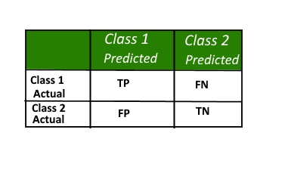
Confusion Matrix
A confusion matrix is a summary of prediction results on a classification problem. The number of correct and incorrect predictions are summarized with count values and broken down by each class. This is the key to the confusion matrix. The confusion matrix shows the ways in which your classification model is confused when it makes predictions. It gives us insight not only into the errors being made by a classifier but more importantly the types of errors that are being made.
Here, Class 1 : Positive Class 2 : Negative
Positive (P) : Observation is positive (for example: is an apple).
Negative (N) : Observation is not positive (for example: is not an apple).
True Positive (TP) : Observation is positive, and is predicted to be positive.
False Negative (FN) : Observation is positive, but is predicted negative.
True Negative (TN) : Observation is negative, and is predicted to be negative.
False Positive (FP) : Observation is negative, but is predicted positive

Slide 15
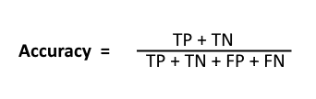


High recall, low precision: This means that most of the positive examples are correctly recognized (low FN) but there are a lot of false positives.
Low recall, high precision: This shows that we miss a lot of positive examples (high FN) but those we predict as positive are indeed positive (low FP)
F-measure:
Since we have two measures (Precision and Recall) it helps to have a measurement that represents both of them. We calculate an F-measure which uses Harmonic Mean in place of Arithmetic Mean as it punishes the extreme values more.
The F-Measure will always be nearer to the smaller value of Precision or Recall.

Slide 16
The following confusion matrix is obtained when the data set is trained with the K – nearest neghbors classification by taking k =9
Confusion Matrix
[[105 20]
[ 23 44]]
Report
precision recall f1-score support
0 0.82 0.84 0.83 125 1 0.69 0.66 0.67 67 accuracy 0.78 192 macro avg 0.75 0.75 0.75 192 weighted avg 0.77 0.78 0.77 192

Slide 17
LOGISTIC REGRESSION
Logistic regression is another technique borrowed by machine learning from the field of statistics.
It is the go-to method for binary classification problems (problems with two class values). In this post you will discover the logistic regression algorithm for machine learning.
After reading this post you will know:
The many names and terms used when describing logistic regression (like log odds and logit).
The representation used for a logistic regression model.
Techniques used to learn the coefficients of a logistic regression model from data.
How to actually make predictions using a learned logistic regression model.
Where to go for more information if you want to dig a little deeper.
This post was written for developers interested in applied machine learning, specifically predictive modeling. You do not need to have a background in linear algebra or statistics.
Logistic Function
Logistic regression is named for the function used at the core of the method, the logistic function.
The logistic function also called the sigmoid function was developed by statisticians to describe properties of population growth in ecology, rising quickly and maxing out at the carrying capacity of the environment. It’s an S-shaped curve that can take any real-valued number and map it into a value between 0 and 1, but never exactly at those limits.
1 / (1 + e^-value)
Where e is the base of the natural logarithms (Euler’s number or the EXP() function in your spreadsheet) and value is the actual numerical value that you want to transform. Below is a plot of the numbers between -5 and 5 transformed into the range 0 and 1 using the logistic function.

Slide 18
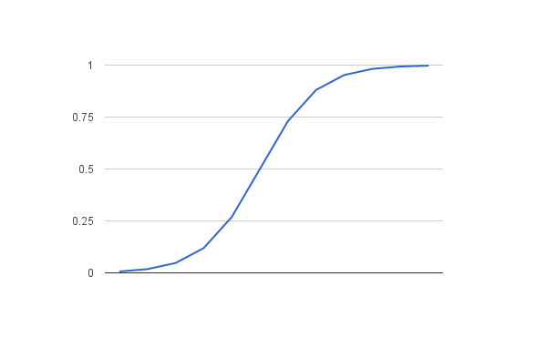
Logistic Function
Representation Used for Logistic Regression
Logistic regression uses an equation as the representation, very much like linear regression.
Input values (x) are combined linearly using weights or coefficient values (referred to as the Greek capital letter Beta) to predict an output value (y). A key difference from linear regression is that the output value being modeled is a binary values (0 or 1) rather than a numeric value.
Below is an example logistic regression equation:
y = e^(b0 + b1*x) / (1 + e^(b0 + b1*x))
Where y is the predicted output, b0 is the bias or intercept term and b1 is the coefficient for the single input value (x). Each column in your input data has an associated b coefficient (a constant real value) that must be learned from your training data.
The actual representation of the model that you would store in memory or in a file are the coefficients in the equation (the beta value or b’s).

Slide 19
By fitting the Data set in to the Logistic regression model, the accuracy , confusion matrix and the report is as follows
Accuracy of Logistic_Regression on training set is 0.78125 Accuracy of Logistic_Regression on testing set is 0.7708333333333334 Confusion Matrix [[110 15]
[ 29 38]]
Report
precision recall f1-score support 0 0.79 0.88 0.83 125 1 0.72 0.57 0.63 67
accuracy 0.77 192 macro avg 0.75 0.72 0.73 192 weighted avg 0.77 0.77 0.76 192

Slide 20
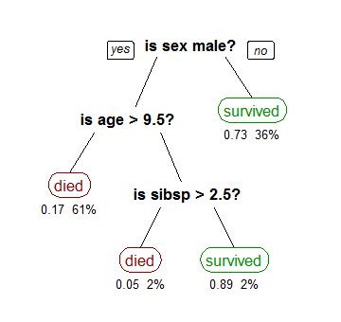
Decision Trees Model
A tree has many analogies in real life, and turns out that it has influenced a wide area of machine learning, covering both classification and regression. In decision analysis, a decision tree can be used to visually and explicitly represent decisions and decision making. As the name goes, it uses a tree-like model of decisions. Though a commonly used tool in data mining for deriveng a strategy to reach a particular goal, its also widely used in machine learning,
Although, a real dataset will have a lot more features and this will just be a branch in a much bigger tree, but you can’t ignore the simplicity of this algorithm. The feature importance is clear and relations can be viewed easily. This methodology is more commonly known as learning decision tree from data and above tree is called Classification tree as the target is to classify passenger as survived or died. Regression trees are represented in the same manner, just they predict continuous values like price of a house. In general, Decision Tree algorithms are referred to as CART or Classification and Regression Trees.
So, what is actually going on in the background? Growing a tree involves deciding on which features to choose and what conditions to use for splitting, along with knowing when to stop. As a tree generally grows arbitrarily, you will need to trim it down for it to look beautiful. Lets start with a common technique used for splitting.

Slide 21
By fitting the Data set in to the Logistic regression model, the accuracy , confusion matrix and the report is as follows
Accuracy of Decision Trees on training set is 0.7725694444444444
Accuracy of Decision Trees on testing set is 0.7395833333333334
Confusion Matrix
[[105 20]
[ 23 44]]
Report
precision recall f1-score support
0 0.82 0.84 0.83 125 1 0.69 0.66 0.67 67
accuracy 0.78 192 macro avg 0.75 0.75 0.75 192 weighted avg 0.77 0.78 0.77 192

Slide 22
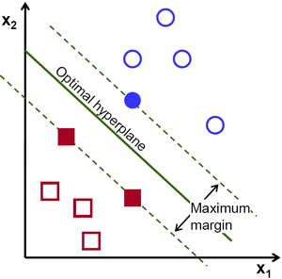
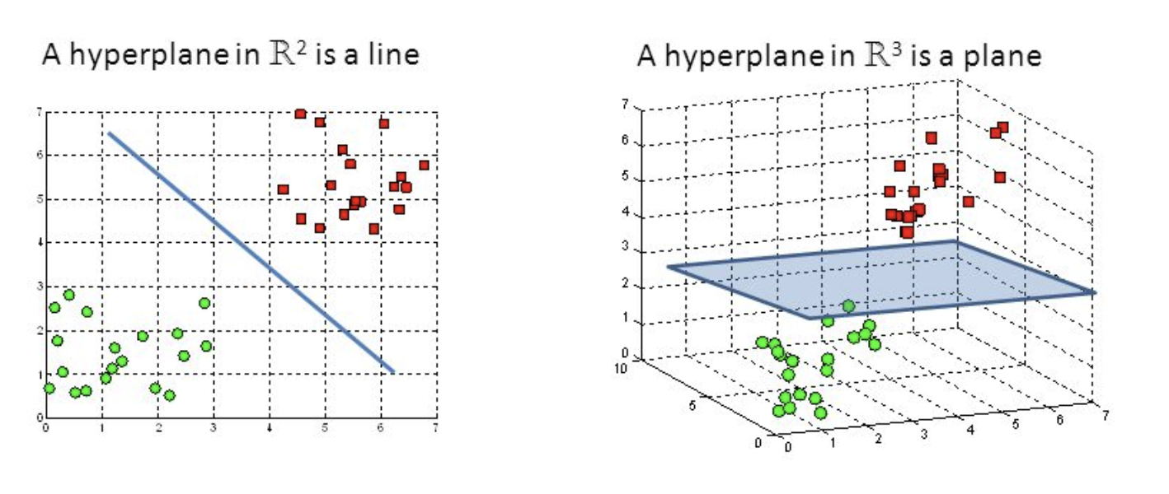
Support Vector Machine
The objective of the support vector machine algorithm is to find a hyperplane in an N-dimensional space(N — the number of features) that distinctly classifies the data points.
To separate the two classes of data points, there are many possible hyperplanes that could be chosen. Our objective is to find a plane that has the maximum margin, i.e the maximum distance between data points of both classes. Maximizing the margin distance provides some reinforcement so that future data points can be classified with more confidence.

Slide 23
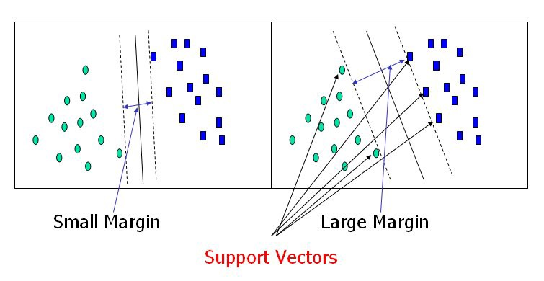
Hyperplanes are decision boundaries that help classify the data points. Data points falling on either side of the hyperplane can be attributed to different classes. Also, the dimension of the hyperplane depends upon the number of features. If the number of input features is 2, then the hyperplane is just a line. If the number of input features is 3, then the hyperplane becomes a two-dimensional plane. It becomes difficult to imagine when the number of features exceeds 3.

Slide 24
By fitting the Data set in to the Logistic regression model, the accuracy , confusion matrix and the report is as follows
Accuracy on training set: 0.790
Accuracy on test set: 0.797
Confusion Matrix
[[105 20]
[ 23 44]]
Report
precision recall f1-score support
0 0.82 0.84 0.83 125 1 0.69 0.66 0.67 67
accuracy 0.78 192 macro avg 0.75 0.75 0.75 192 weighted avg 0.77 0.78 0.77 192

Slide 25
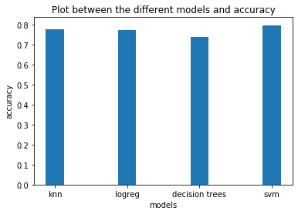

Slide 26
Conclusion:
Thus the Diabetes dataset is fitted in to the different classification models , predicted labels , confusion matrix, precision, recall, accuracy of model. Finally comparing the accuracies of all models, the Support Vector Machine got the highest accuracy with 0.797 among other models which are used in this project

